Slide 1












Topic: Local Economic Development through MSMEs
Market Demand Prediction for MSMEs
“MADEFOR”
Market Demand Forecasting
Team 7 Innovation Challange

Slide 2



Meet Team 7 Member
Mentoring by Aziz Muslim & Hartono Wahyu
An Naffila Putri Prasari
Aria Hadid A
Saniyyah Oesman
Arifandi Wahyu Ramadhan
Mirza Maulana Azmi
Dinar Mahendra Puspasari

Slide 3
Problem Statement
Micro, Small, and Medium Enterprises (MSMEs) play a vital role in driving the national economy. However, they often encounter challenges in developing efficient production plans and accurately estimating market demand.
Target Users
The target of this platform is Micro, Small and Medium Enterprises (MSMEs)
Solution
By leveraging AI technology, the platform will analyze various factors including historical sales data, market trends, seasonality, and other variables to provide reliable estimates of the demand for certain products in these regions. In this way, MSMEs can reduce the risk of overstock or understock, increase production efficiency and optimize their income.

Slide 4

Unique Value Proposition
Historical Data Analysis:
The platform analyzes historical sales data of SMEs, understanding consumer behavior and factors influencing demand.
Demand Prediction:
Using machine learning, it predicts market demand considering seasonality and market trends, enhancing accuracy.
Data Visualization:
Results are presented through clear graphs and dashboards, aiding SMEs in understanding demand forecasts.
Production Recommendations:
Based on predictions, the platform suggests optimal production quantities, minimizing inventory risks.

Slide 5
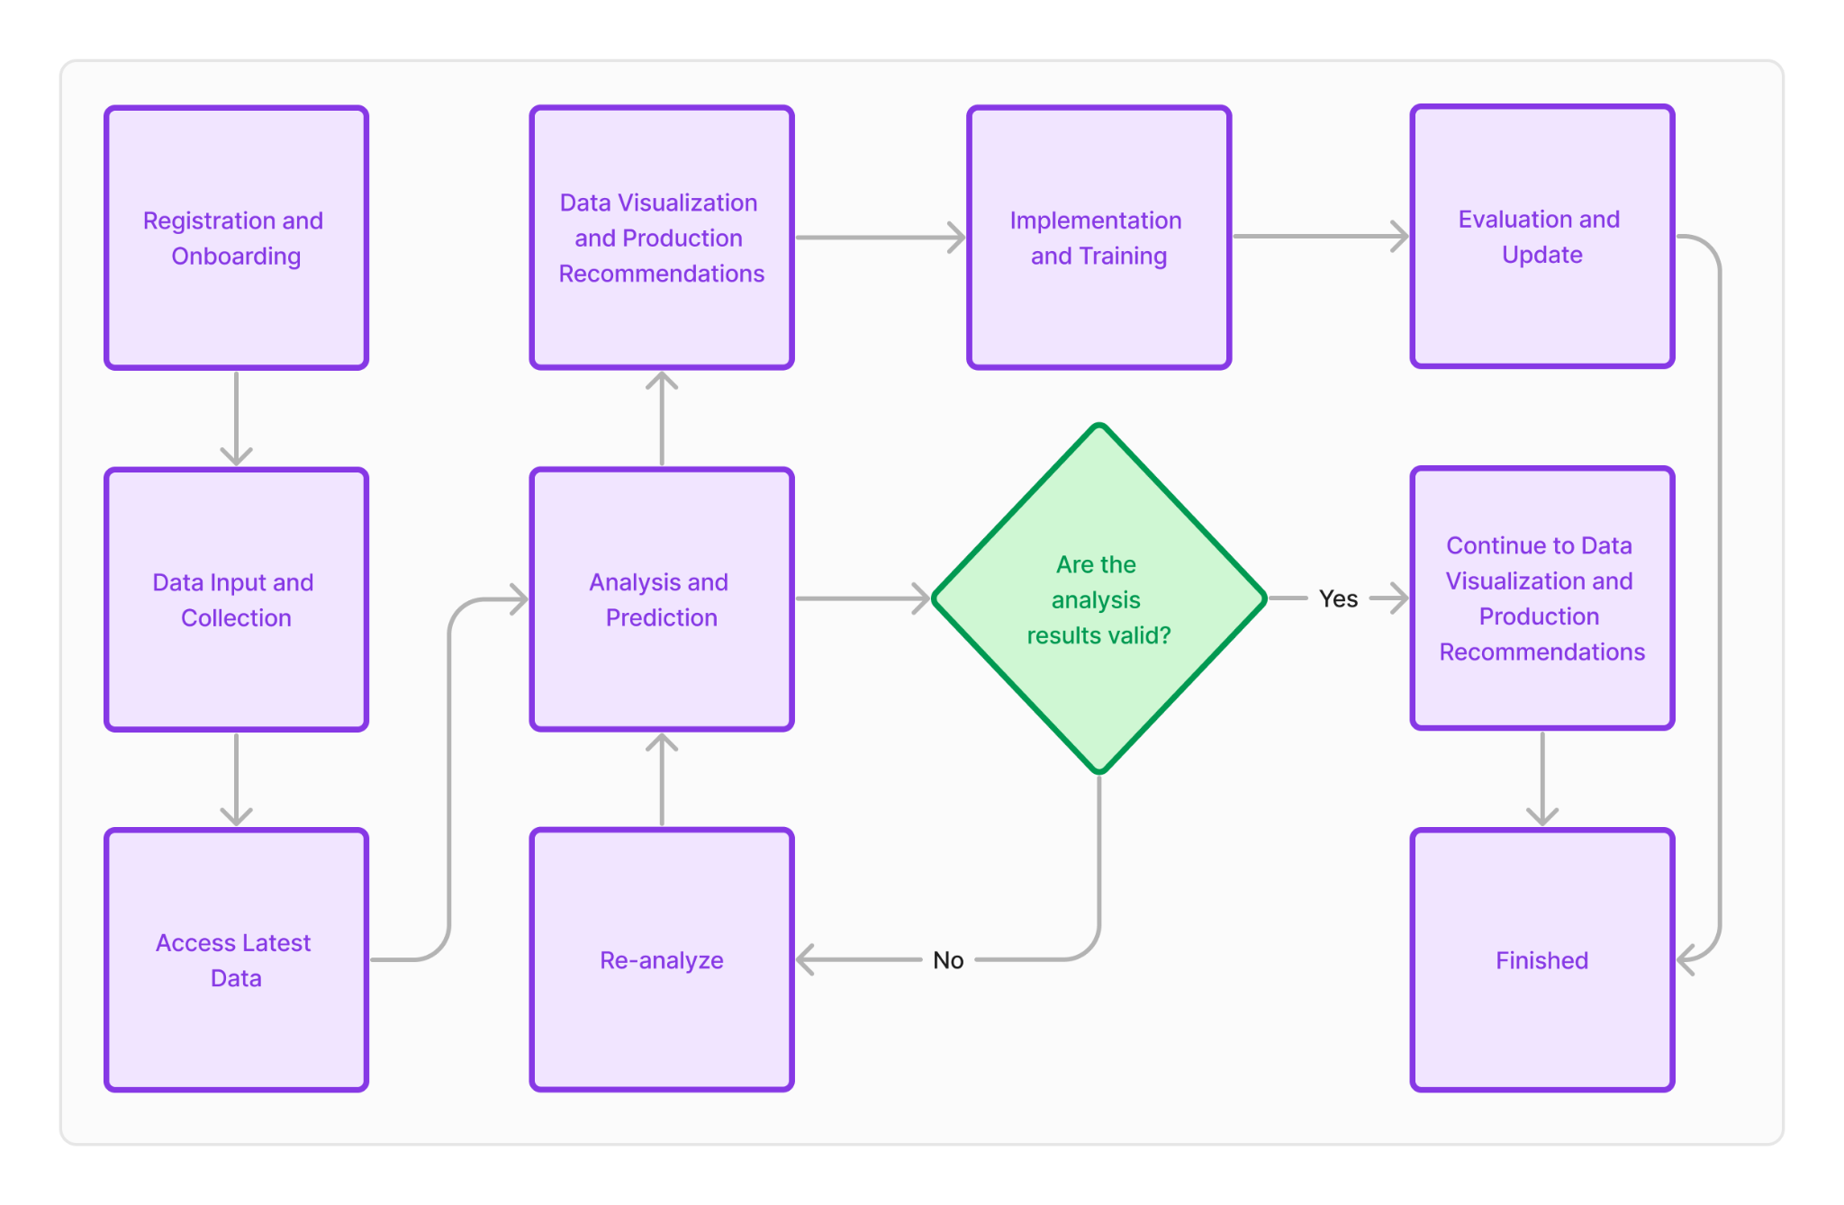
Business Flow

Slide 6



Dataset
Features | Description
provinsi | province where MSME products are marketed
kab/kota | district/city where MSME products are marketed
produk | name of the product
kategori | types of products
kualitas | quality of products
harga_min | lowest price of the products
harga_max | highest price of the products
harga_avg | average price of the products
harga_modal | manufacturing or product acquisition costs
penjualan | number of products sold in a certain period
tanggal | date when the sale was made
sales | gives the total sales for a products
Dataset Info
12 columns & 1460 rows
6 numerical features
6 categorical features
No missing value
No duplicate data
* dataset is generated

Slide 7

DEMO
PROJECT
Notes:
Link power BI website: Click on the shape

Slide 8
Next Action
Platform Development and Enhancement: The team will continuously develop new features and improve the platform's performance, including optimizing prediction algorithms and integrating inventory systems. The goal is to ensure the platform remains effective in providing accurate forecasts for MSMEs.
Feedback Collection and Analysis: User feedback will be collected and analyzed to identify platform improvements. This ensures a better user experience and overall platform effectiveness.
Advanced Training: Additional training will be provided to ensure optimal platform usage, focusing on data analysis and interpretation of predictions for MSMEs.
Developing Relationships with Stakeholders: Relationships with local governments, financial institutions, and communities will be enhanced to support MSMEs and promote platform usage.
Exploring Alternative Business Models: The platform will explore alternative business models, such as subscription-based or revenue-sharing models, to increase revenue and service coverage for MSMEs.
Marketing and Promotion: Extensive marketing campaigns will be conducted through online and offline channels, as well as partnerships with local communities to increase awareness and adoption of the platform.
Monitoring and Performance Evaluation: The platform's performance will be continuously monitored and evaluated to ensure the effectiveness of implemented strategies and provide necessary improvements.

Slide 9
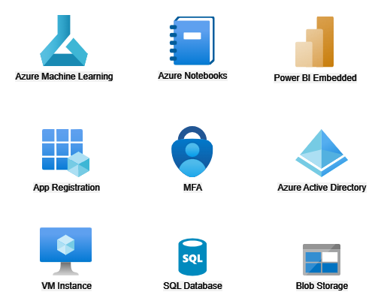
Azure Products That Being Used

Slide 10
THANK YOU

